Slide 1
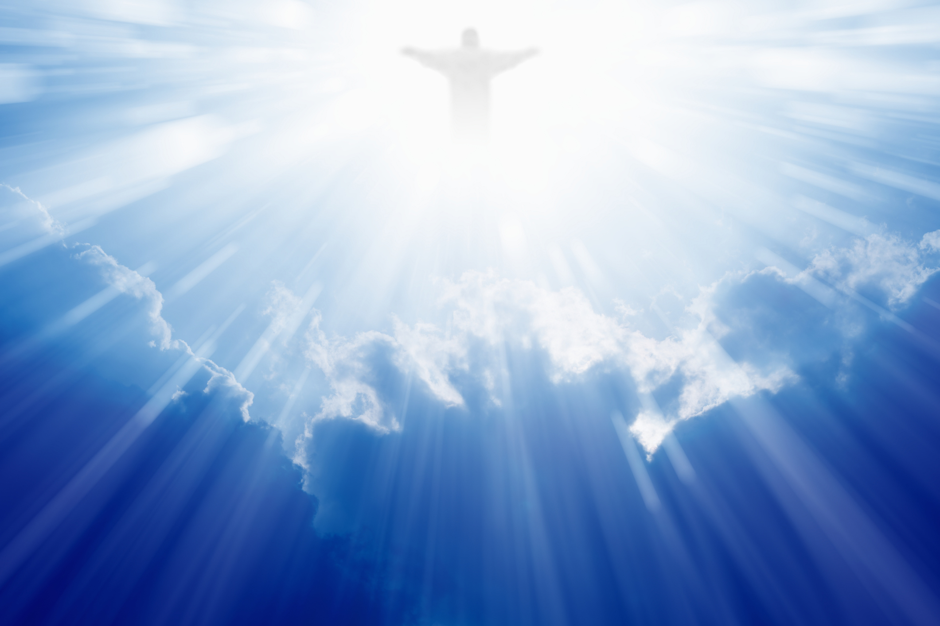
你是荣耀君王
You Are The King Of Glory

Slide 2
你是荣耀的君王 你是和平之主
你是天地万有主宰 唯有你圣洁公义
You are the king of glory
You are the prince of peace
You are the Lord of heaven and earth
You are the son of righteousness
你是荣耀君王 1/3

Slide 3
天使都向你跪下 敬拜尊崇你
因为在你有永生之道
你是主耶稣基督
Angels bow down before You
Worship and adore
For You are the words of eternal life
You are Jesus Christ the Lord
你是荣耀君王 2/3

Slide 4
和散那 归于 大卫的子孙
和散那 归于 万王之王
愿荣耀归于至高神 耶稣是弥赛亚
Hosanna to the Son of David
hosanna to the King of kings
Glory in the highest heaven,
For Jesus the Messiah reigns.
你是荣耀君王 3/3

Slide 5
你是荣耀的君王 你是和平之主
你是天地万有主宰 唯有你圣洁公义
You are the king of glory
You are the prince of peace
You are the Lord of heaven and earth
You are the son of righteousness
你是荣耀君王 1/3

Slide 6
天使都向你跪下 敬拜尊崇你
因为在你有永生之道
你是主耶稣基督
Angels bow down before You
Worship and adore
For You are the words of eternal life
You are Jesus Christ the Lord
你是荣耀君王 2/3

Slide 7
和散那 归于 大卫的子孙
和散那 归于 万王之王
愿荣耀归于至高神 耶稣是弥赛亚
Hosanna to the Son of David
hosanna to the King of kings
Glory in the highest heaven,
For Jesus the Messiah reigns.
你是荣耀君王 3/3

Slide 8
和散那 归于 大卫的子孙
和散那 归于 万王之王
愿荣耀归于至高神 耶稣是弥赛亚
Hosanna to the Son of David
hosanna to the King of kings
Glory in the highest heaven,
For Jesus the Messiah reigns.
你是荣耀君王 3/3

Slide 9
和散那 归于 大卫的子孙
和散那 归于 万王之王
愿荣耀归于至高神 耶稣是弥赛亚
Hosanna to the Son of David
hosanna to the King of kings
Glory in the highest heaven,
For Jesus the Messiah reigns.
你是荣耀君王 3/3

