Slide 1

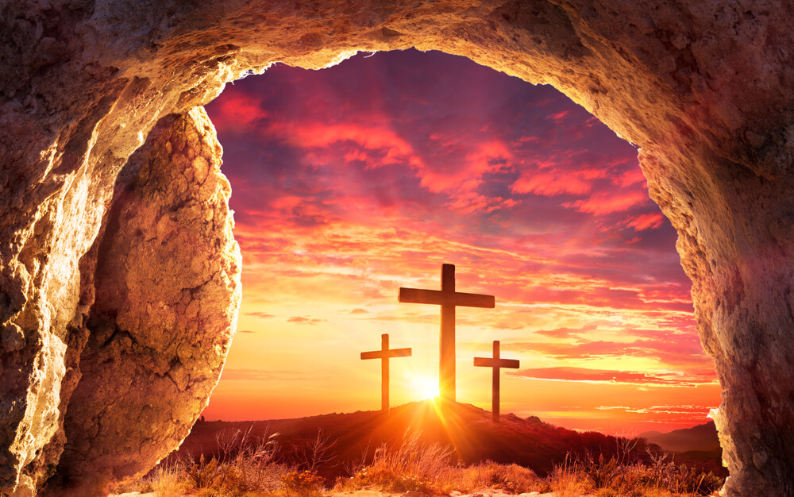
两个亚当，两种生命
Two Adams, Two Lives
罗/Rom.5:12-21

Slide 2

祈祷/Prayer

Slide 3
一、亚当的悖逆——罪进入世界（12-14节）
I. Adam‘s Disobedience: Sin Entered the World (vv. 12–14)
12 这就如罪是从一人入了世界，死又是从罪来的；于是死就临到众人，因为众人都犯了罪。 12Therefore, just as sin entered the world through one man, and death through sin, and in this way death came to all people, because all sinned.

Slide 4
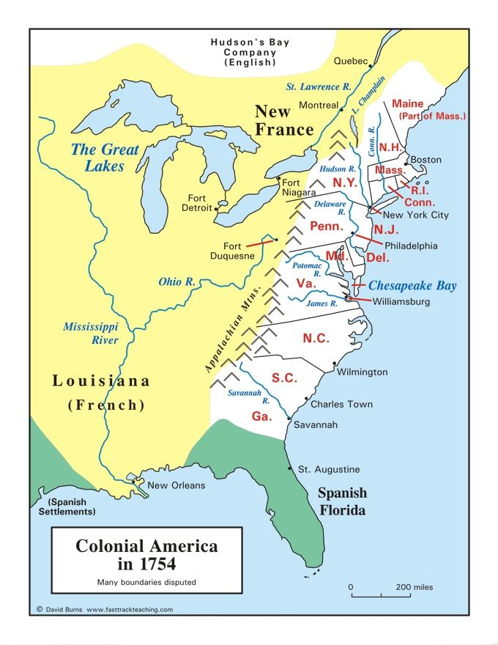
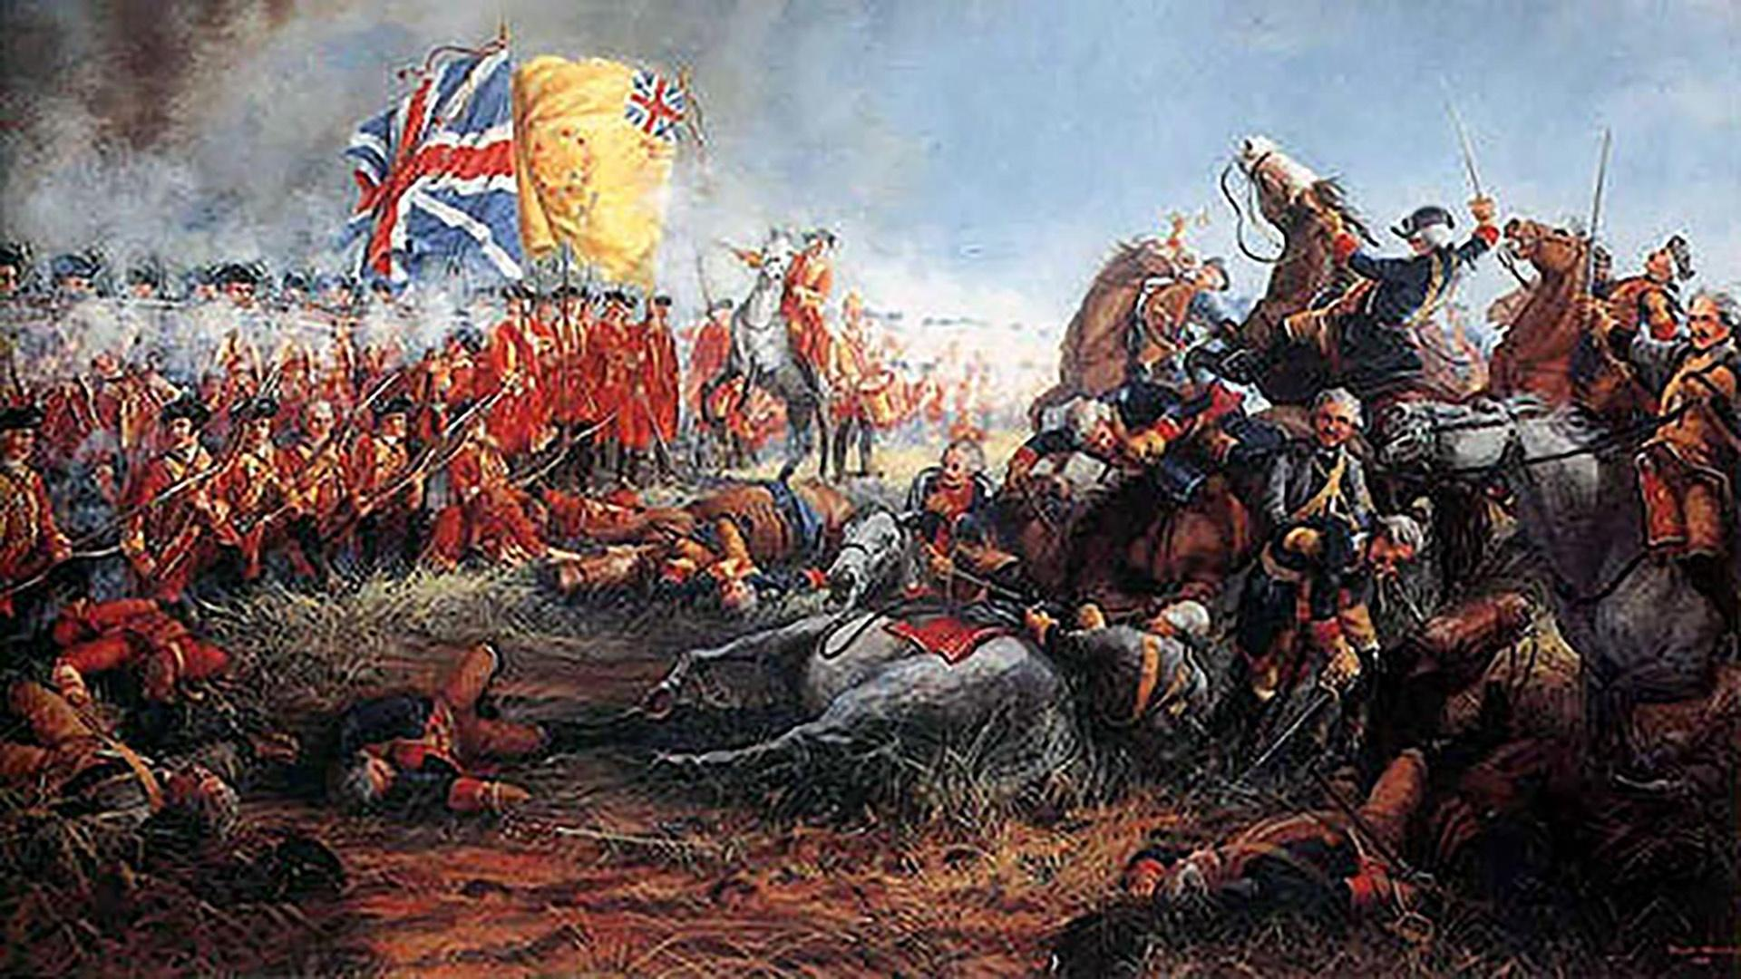
罗

Slide 5
16 园中各样树上的果子，你可以随意吃；只是分别善恶树上的果子，你不可吃，因为你吃的日子必定死。
16 And the Lord God commanded the man, “You are free to eat from any tree in the garden; 17but you must not eat from the tree of the knowledge of good and evil, for when you eat from it you will certainly die.”
创/Gen. 2：16-17

Slide 6
4蛇对女人说，你们不一定死，5因为神知道，你们吃的日子眼睛就明亮了，你们便如神能知道善恶。
4“You will not certainly die,” the serpent said to the woman. 5“For God knows that when you eat from it your eyes will be opened, and you will be like God, knowing good and evil.”
创/Gen. 3:4-5

Slide 7
二、基督的顺服——恩典胜过罪（15-19节）
II. Christ's Obedience: Grace Conquered Sin (vv. 15–19)

Slide 8
15只是过犯不如恩赐。若因一人的过犯，众人都死了，何况神的恩典，与那因耶稣基督一人恩典中的赏赐，岂不更加倍地临到众人吗？
15But the gift is not like the trespass. For if the many died by the trespass of the one man, how much more did God’s grace and the gift that came by the grace of the one man, Jesus Christ, overflow to the many!

Slide 9
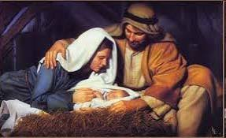
二、基督的顺服——恩典胜过罪（15-19）
II. Christ's Obedience: Grace Conquered Sin (15–19)
（一）耶稣必须以真实的人来面对试探
1. Jesus Had to Face Temptation as a True Human Being

Slide 10
二、基督的顺服——恩典胜过罪（15-19）
II. Christ's Obedience: Grace Conquered Sin (15–19)
（二）耶稣必须重新面对亚当所面对的试探
2. Jesus Had to Face the Same Temptation That Adam Faced

Slide 11
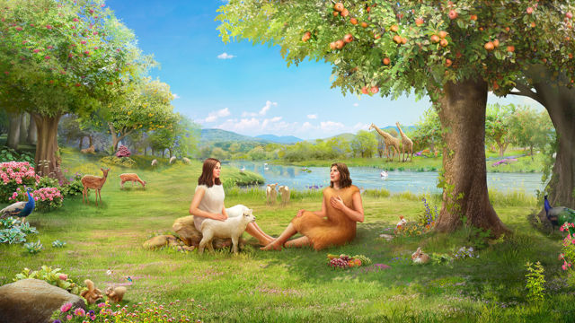
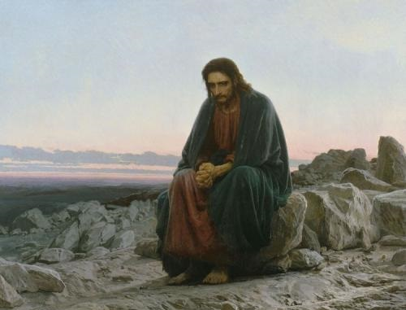
亚当在伊甸园遇到“蛇”的诱惑
耶稣被圣灵引到旷野，受魔鬼的试探。太4:1
伊甸园
旷野
是一个完美的世界。没有疾病。没有死亡。没有眼泪。没有荆棘。没有痛苦。园中的果子可以随意吃。动物也不会伤害人。
是一个已经堕落的世界。没有丰富的果子。没有舒适的环境。没有人的陪伴。只有炎热的白天，寒冷的夜晚，还有野兽的危险。

Slide 12
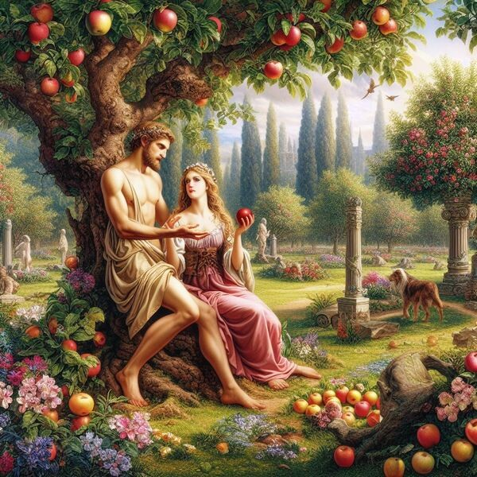
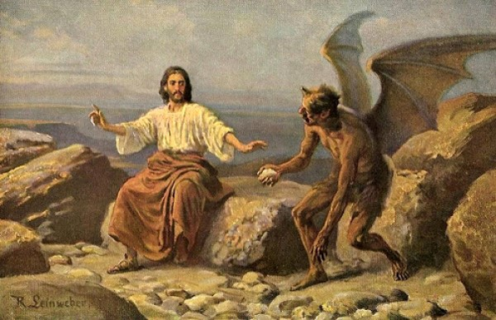
当时，园中各样树上的果子，亚当可以随意吃。所以，在他接受试探的时候，有可能他刚刚吃饱。没有任何缺乏。同时，他还有夏娃和动物们的陪伴。
亚当
耶稣
伊甸园
旷野
“他禁食了四十昼夜，后来就饿了。”(太4:2)
为什么圣经要特别强调"后来就饿了"？因为人在饥饿、孤单、无助的时候，最容易落入试探之中。

Slide 13

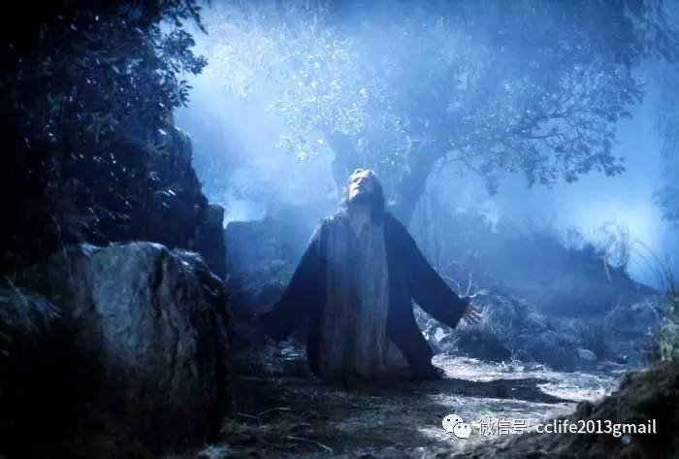
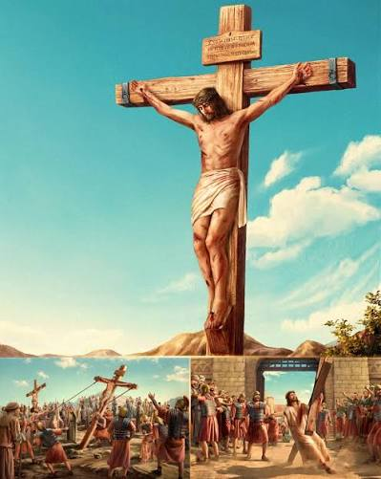
伊甸园一次的试探
亚当
耶稣
旷野
伊甸园
耶稣面对的是一生的顺服。旷野只是开始。真正最大的试探，是在客西马尼园……我父啊，倘若可行，求你叫这杯离开我。然而，不要照我的意思，只要照你的意思。

Slide 14
15若因一人的过犯，众人都死了，何况神的恩典，与那因耶稣基督一人恩典中的赏赐，岂不更加倍地临到众人吗……17若因一人的过犯，死就因这一人作了王，何况那些受洪恩又蒙所赐之义的，岂不更要因耶稣基督一人在生命中作王吗？
15For if the many died by the trespass of the one man, how much more did God’s grace and the gift that came by the grace of the one man, Jesus Christ, overflow to the many...17For if, by the trespass of the one man, death reigned through that one man, how much more will those who receive God’s abundant provision of grace and of the gift of righteousness reign in life through the one man, Jesus Christ!

Slide 15
三、你的选择——活在亚当里，还是活在基督里（20-21）
III. Your Choice: Will You Live in Adam or in Christ? (20–21)
21就如罪作王叫人死，照样恩典也借着义作王，叫人因我们的主耶稣基督得永生。
21so that, just as sin reigned in death, so also grace might reign through righteousness to bring eternal life through Jesus Christ our Lord.

Slide 16
总结
Summary

