Slide 1

从背叛到救赎——神与祂子民的爱恨情深
From Betrayal to Redemption: The Deep Love and Pain Between
God and His People
何/Hos. 1:1-9

Slide 2
旧约
摩西五经
历史书
诗歌智慧书
先知书
《创》《出》《利》《民》《申》
《书》《士》《路》《撒上、下》《王上、下》《代上、下》《拉》《尼》《斯》
《伯》《诗》《箴》《传》《歌》
《赛》《耶》《结》《但》《哀》《何》《珥》《摩》《俄》《拿》《迦》《鸿》《谷》《番》《该》《亚》《玛》

Slide 3

祈祷/Prayer

Slide 4
以色列统一王国
The united Kingdom of Israel
南国犹大 北国以色列
The Soouthern kingdom: Judah The Northern Kingdom: Israel
（2个支派/2 tribes） （10个支派/10 tribes）
一、何西阿事奉时期的历史背景 1:1
I. The Historical Context of Hosea’s Ministry 1:1

Slide 5
1：1节当乌西雅，约坦，亚哈斯，希西家作犹大王，约阿施的儿子耶罗波安，作以色列王的时候，耶和华的话临到备利的儿子何西阿。
1The word of the Lord that came to Hosea son of Beeri during the reigns of Uzziah, Jotham, Ahaz and Hezekiah, kings of Judah, and during the reign of Jeroboam son of Joash king of Israel:

Slide 6
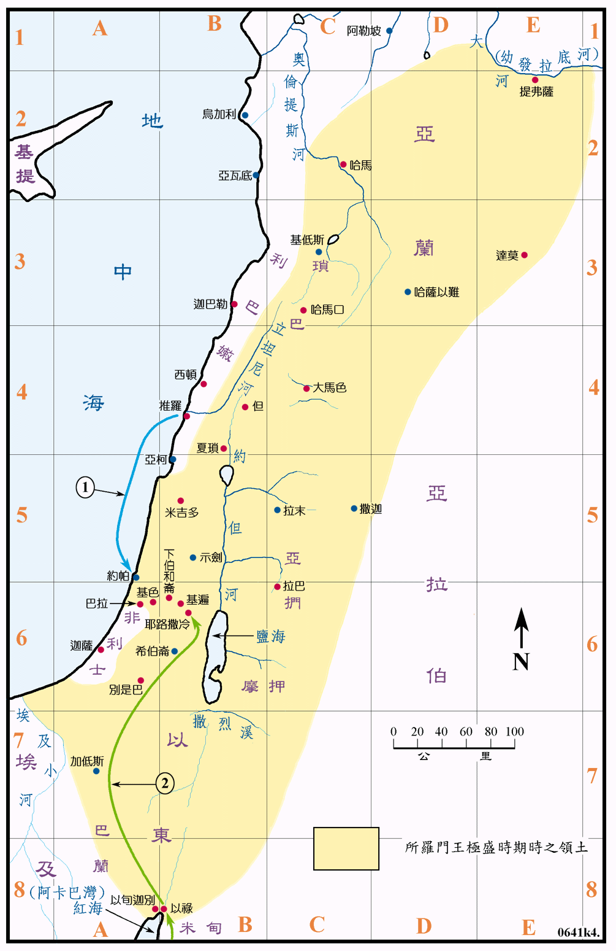
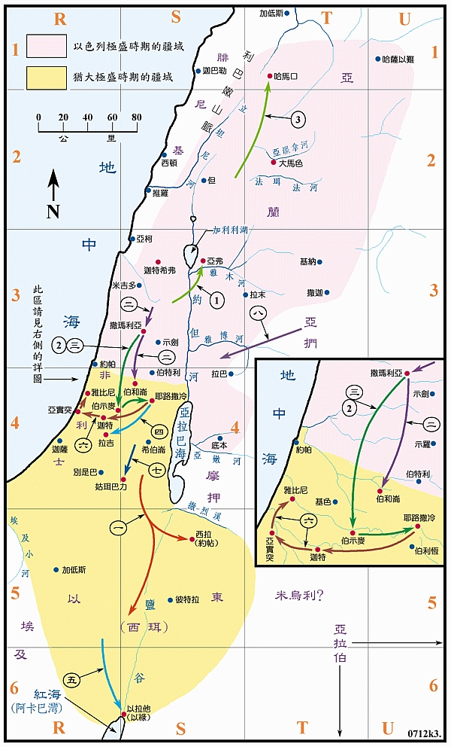

Slide 7
1.谎言、虚假（何4:1）
2.奸淫（何7：4）
3.杀人流血（何5：2）
4.强夺奢华（何10：13）
5.人多行诡诈(何12:7)
6.不公义（何10：4 )
7.虐待穷人 摩2：7
Lies and Deceit (Hosea 4:1)
Adultery (Hosea 7:4)
Murder and Bloodshed (Hosea 5:2)
Violence and Luxury (Hosea 10:13)
Widespread Deceitfulness (Hosea 12:7)
Injustice (Hosea 10:4)
Oppression of the Poor (Amos 2:7)

Slide 8
一
 | 真实的信仰 True Faith | 按人私欲所塑造的信仰 faith shaped by human selfish desires
中心 Center | 以神为中心 God-centered | 以自我为中心 Self-centered
信仰目的 Purpose of Faith | 荣耀神,遵行祂的旨意 To glorify God and do His will | 满足个人需求 To satisfy personal needs
标准 Standard | 神的真理,公义,圣洁 God's truth, justice, holiness | 我的想法,喜好,欲望 My ideas, preferences, desires
信仰表现 Expression | 顺服、敬畏、信靠 Obedience, reverence, trust | 利用、选择性顺服 Use of faith, selective obedience
结果 Outcome | 灵命成长,讨神喜悦 Spiritual growth, pleasing God | 自我放纵,远离真 Self-indulgence, drifting from truth

Slide 9
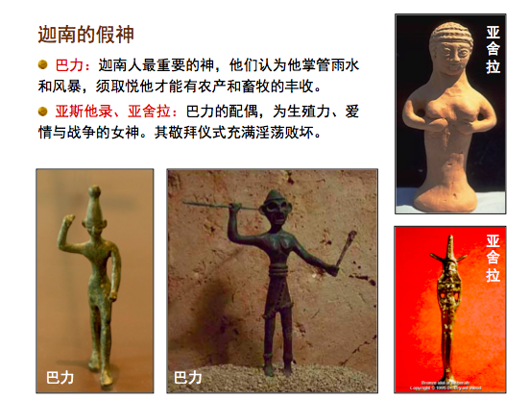
一

Slide 10
二，何西阿的呼召与使命 2-3a
II. Hosea’s Calling and Mission 2-3a
耶和华初次与何西阿说话，对他说，你去娶淫妇为妻，也收那从淫乱所生的儿女，因为这地大行淫乱，离弃耶和华。3于是，何西阿去娶了滴拉音的女儿歌篾……。
2When the Lord began to speak through Hosea, the Lord said to him, ‘Go, marry a promiscuous woman and have children with her, for like an adulterous wife this land is guilty of unfaithfulness to the Lord.’ 3So he married Gomer daughter of Diblaim…

Slide 11
如果今天神这样的命令临到你我身上，我们会做出怎样的回应？换句话说，如果今天神吩咐你去做一件你本不愿意去做的事情，你愿意顺服吗？
If such a command from God were given to you today, how would you respond? In other words, if God asked you to do something you didn’t want to do — would you be willing to obey?

Slide 12
三，何西阿为三个儿女取名的意义 3b-9
III,The Naming of Hosea’s Three Children and Its Significance
3……这妇人怀孕，给他生了一个儿子。4耶和华对何西阿说，给他起名叫耶斯列，因为再过片时，我必讨耶户家在耶斯列杀人流血的罪，也必使以色列家的国灭绝。
3…she conceived and bore him a son. 4Then the Lord said to Hosea, ‘Call him Jezreel, because I will soon punish the house of Jehu for the massacre at Jezreel, and I will put an end to the kingdom of Israel.

Slide 13
6歌篾又怀孕生了一个女儿，耶和华对何西阿说，给她起名叫罗路哈玛，因为我必不再怜悯以色列家，决不赦免他们。8歌篾给罗路哈玛断奶以后，又怀孕生了一个儿子。9耶和华说，给他起名叫罗阿米，因为你们不作我的子民，我也不作你们的神。
6Gomer conceived again and gave birth to a daughter. Then the Lord said to Hosea, ‘Call her Lo-Ruhamah (which means “not loved”), for I will no longer show love to Israel, that I should at all forgive them. 8After she had weaned Lo-Ruhamah, Gomer had another son. 9Then the Lord said, ‘Call him Lo-Ammi (which means “not my people”), for you are not my people, and I am not your God.

Slide 14
1、耶斯列——神审判。原文：神栽种；在何西阿书中具有审判的象征意义。
2、罗路哈玛——不蒙怜悯
3、罗阿米——非我民
1, Jezreel — Original meaning: God sows; in the Book of Hosea, it symbolizes judgment.
2,Lo-Ruhamah — Not shown mercy or Not Loved.
3,Lo-Ammi — Not my people.

Slide 15
总结
Summary

