Slide 1
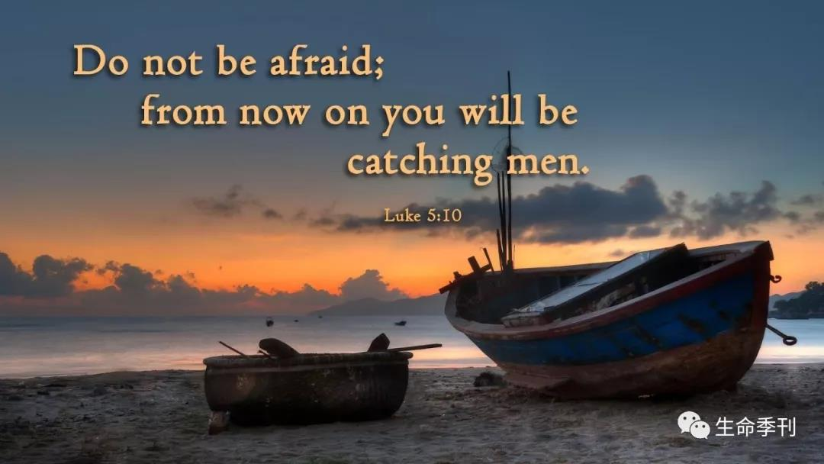
在牧长之下的侍奉——长老的呼召 Serving Under the Chief Shepherd — The Calling of Elders 彼前/1Peter：5：1-4

Slide 2

祈祷/Prayer

Slide 3
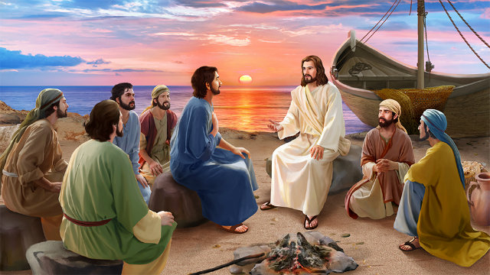
5：1-2 我这作长老、作基督受苦的见证，同享后来所要显现之荣耀的，劝你们中间与我同作长老的人；务要牧养在你们中间神的群羊。
1To the elders among you, I appeal as a fellow elder and a witness of Christ’s sufferings who also will share in the glory to be revealed: 2be shepherds of God’s flock that is under your care, watching over them

Slide 4
大牧者主耶稣的重托 使徒们 历世历代神的仆人们 梁长老、戴长老、王长老、陈长老 尹长老、庞长老、朱长老、Eva 长老 德玉弟兄

Slide 5
一、长老的呼召：一份危险的呼召 I. The Calling of Elders: A Calling Marked by Danger 1、向神交账的呼召 1. A calling for which one must give an account before God.

Slide 6
来13：17 你们要依从那些引导你们的，且要顺服，他们为你们的灵魂时刻警醒，好像那将来要交账的人。 17Have confidence in your leaders and submit to their authority, because they keep watch over you as those who must give an account.

Slide 7

2、容易跌倒，容易被攻击的呼召 2. A calling that is vulnerable to failure and spiritual attack.
弗 6：16 此外又拿着信德当作藤牌，可以灭尽那恶者一切的火箭。

Slide 8
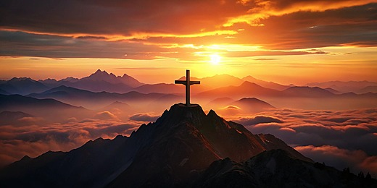
3、不能为自己而活的呼召 3. A calling that demands a life no longer lived for oneself.

Slide 9
2务要牧养在你们中间神的群羊，按着神旨意照管他们。不是出于勉强，乃是出于甘心。也不是因为贪财，乃是出于乐意。3也不是辖制所托付你们的，乃是作群羊的榜样。 2be shepherds of God’s flock that is under your care, watching over them – not because you must, but because you are willing, as God wants you to be; not pursuing dishonest gain, but eager to serve; 3not lording it over those entrusted to you, but being examples to the flock.

Slide 10
出于喜好 产生比较 勉强不甘心 受伤
受伤
不甘心
受伤
勉强
软弱、跌倒；
不服侍；
甚至离弃信仰

Slide 11
带出合神心意的行为（彼此配搭,不辖制人） 产生纯正的动机（为荣耀神、造就人） 带来心态的平衡（甘心乐意、忠心委身） 定位正确（照着神的旨意而服侍）

Slide 12
二、长老的呼召：一份荣耀的呼召 II. The Calling of Elders: A Calling Marked by Glory 4到了牧长显现的时候，你们必得那永不衰残的荣耀冠冕。 4And when the Chief Shepherd appears, you will receive the crown of glory that will never fade away.

Slide 13
1、与牧长同工的呼召 1. A calling to serve alongside the Chief Shepherd. 4到了牧长显现的时候，你们必得那永不衰残的荣耀冠冕。4And when the Chief Shepherd appears, you will receive the crown of glory that will never fade away.

Slide 14
2、将来必被主肯定的呼召 2. A calling that will one day be affirmed and rewarded by the Lord Himself. 4到了牧长显现的时候，你们必得那永不衰残的荣耀冠冕。 4 And when the Chief Shepherd appears, you will receive the crown of glory that will never fade away.

Slide 15
3、值得全教会一同珍惜的呼召 3. A calling worthy of being treasured and upheld by the entire church. 来13：17 你们要依从那些引导你们的，且要顺服，他们为你们的灵魂时刻警醒，好像那将来要交账的人 17Have confidence in your leaders and submit to their authority, because they keep watch over you as those who must give an account.

Slide 16

总结 Summary

