Slide 1
我们是天国子民 We are citizens of heaven 腓 3：17-21 Phil. 3: 17-21

Slide 2
耶29：10 “耶和华如此说，为巴比伦所定的七十年满了以后，我要眷顾你们，向你们成就我的恩言，使你们仍回此地。 10This is what the Lord says: ‘When seventy years are completed for Babylon, I will come to you and fulfil my good promise to bring you back to this place. ---耶29：10/Jer.29:10

Slide 3
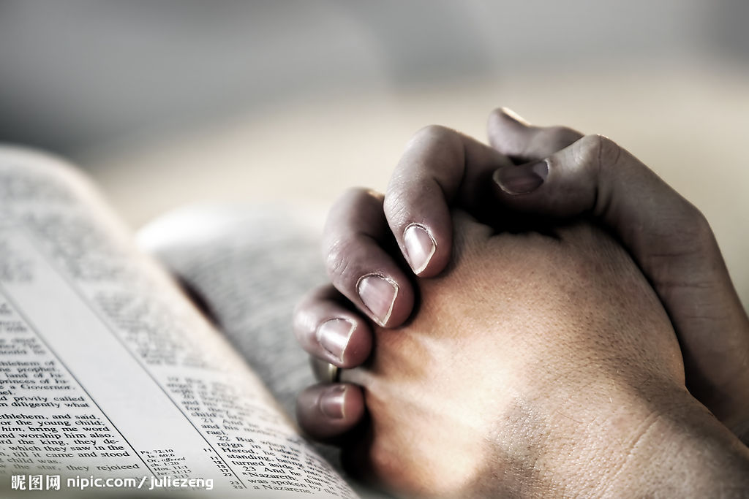
祈祷 Prayer

Slide 4
首先，部分腓立比信徒在信仰上出现了偏差 First, some of them in the church of Philippi had deviated from their beliefs. “应当防备犬类，防备作恶的，防备妄自行割的。因为真受割礼的，乃是我们这以神的灵敬拜，在基督耶稣里夸口，不靠着肉体的”。 2 Watch out for those dogs, those evildoers, those mutilators of the flesh. 3 For it is we who are the circumcision, we who serve God by his Spirit, who boast in Christ Jesus, and who put no confidence in the flesh ---腓3：2-3/Phil. 3:2-3

Slide 5
其次，部分腓立比信徒在生活上迷失重心 Second, some of them in the church of Philippi had problems in their lives. 他们的神就是自己的肚腹，他们以自己的羞辱为荣耀，专以地上的事为念。 their god is their stomach, and their glory is in their shame. Their mind is set on earthly things. ----腓3：19/Phil. 3:19

Slide 6
最后，部分腓立比信徒在服侍中出现了问题 Finally, some of them in the church of Philippi had problems when they did their ministries. 2你们就要意念相同，爱心相同，有一样的心思，有一样的意念，使我的喜乐可以满足。3凡事不可结党，不可贪图虚浮的荣耀。只要存心谦卑，各人看别人比自己强。4各人不要单顾自己的事，也要顾别人的事。 Then make my joy complete by being like-minded, having the same love, being one in spirit and of one mind. Do nothing out of selfish ambition or vain conceit. Rather, in humility value others above yourselves, not looking to your own interests but each of you to the interests of the others. ----腓2：2-4/Phil.2:2-4

Slide 7
一、天国子民应当效法保罗的榜样 I. The citizens of heaven should follow the example of Paul. 弟兄们，你们要一同效法我，也当留意看那些照我们榜样行的人。 Join together in following my example, brothers and sisters, and just as you have us as a model, keep your eyes on those who live as we do. ----腓3：17/Phil.3:17

Slide 8
ἐπιλανθάνομαι
forget：忘记
neglect：忽视，不被重视

Slide 9
血统：便雅悯支派的人 Blood: The tribe of Benjamin 身份：罗马公民 Identity: the citizenship of Rome 学历： 受教于迦玛列门下 Education: studied with Gamaliel 信仰： Belief:
保罗
就律法说：我是法利赛人
In regard to the law, a Pharisee
就热心说：我是逼迫教会的
As for zeal, persecuting the church
律法上的义：我是无可指摘的
As for legalistic righteousness, faultless

Slide 10
徒8：3“扫罗却残害教会，进各人的家，拉着男女下在监里。” Saul began to destroy the church. Going from house to house, he dragged off both men and women and put them in prison. ---徒8：3/Acts 8:3

Slide 11
徒9：1“扫罗仍然向主的门徒，口吐威吓凶杀的话，去见大祭司，2求文书给大马色的各会堂，若是找着信奉这道的人，无论男女，都准他捆绑带到耶路撒冷。” 1Meanwhile, Saul was still breathing out murderous threats against the Lord’s disciples. He went to the high priest 2and asked him for letters to the synagogues in Damascus, so that if he found any there who belonged to the Way, whether men or women, he might take them as prisoners to Jerusalem. ----徒9:1-2/Acts 9:1-2

Slide 12
διώκω
Persecuting：正在逼迫/迫害
Pursuing: 正在从事/追赶

Slide 13
我从前是亵渎神的，逼迫人的，侮慢人的。然而我还蒙了怜悯，因我是不信不明白的时候而作的……基督耶稣降世，为要拯救罪人。这话是可信的，是十分可佩服的。在罪人中我是个罪魁。然而我蒙了怜悯，是因耶稣基督要在我这罪魁身上，显明他一切的忍耐，给后来信他得永生的人作榜样。 Even though I was once a blasphemer and a persecutor and a violent man, I was shown mercy because I acted in ignora- nce and unbelief. Here is a trustworthy saying that deserves full acceptance: Christ Jesus came into the world to save sinners – of whom I am the worst. But for that very reason I was shown mercy so that in me, the worst of sinners, Christ Jesus might display his immense patience as an example for those who would believe in him and receive eternal life. ---提前1：13-16/1Tim.1:13-16

Slide 14
二、天国子民应当防备十字架的仇敌 II. The citizens of heaven should be on guard against enemies of the cross of Christ

Slide 15
18因为有许多人行事，是基督十字架的仇敌。我屡次告诉你们，现在又流泪地告诉你们。19他们的结局就是沉沦，他们的神就是自己的肚腹，他们以自己的羞辱为荣耀，专以地上的事为念。 18 For, as I have often told you before and now tell you again even with tears, many live as enemies of the cross of Christ. 19 Their destiny is destruction, their god is their stomach, and their glory is in their shame. Their mind is set on earthly things. ----腓3：18-19/Phil.3:18-19

Slide 16
κλαίω
Weep: 流泪，哭泣
Mourn：忧伤，哀痛 Lament：悲叹，痛惜

Slide 17
十字架显明人完全的堕落和人来到上帝面前的惟一方式是藉着“信” The cross not only reveals the total depravity of humanity, but also reveals that the only way to God is by faith. 十字架显明上帝的绝对公义，圣洁,和上帝无私的爱属性 The cross reveals God’s absolute justice， holiness，and unselfish love .

Slide 18
三、天国子民应热切等候耶稣的再临 III. The citizens of heaven should eagerly await the second coming of Jesus Christ

Slide 19
20我们却是天上的国民。并且等候救主，就是主耶稣基督，从天上降临。21他要按着那能叫万有归服自己的大能，将我们这卑贱的身体改变形状，和他自己荣耀的身体相似。 But our citizenship is in heaven. And we eagerly await a Savior from there, the Lord Jesus Christ, who, by the power that enables him to bring everything under his control, will transform our lowly bodies so that they will be like his glorious body. ----腓3：18-19/Phil.3:18-19

Slide 20
12节“我不是说我已经得着了，已经完全了，我乃是竭力追求，或者可以得着基督耶稣所以得着我的（“所以得着我的”或作“所要我得的”）” 12 Not that I have already obtained all this, or have already arrived at my goal, but I press on to take hold of that for which Christ Jesus took hold of me.

Slide 21
亚基帕王啊，我故此没有违背那从天上来的异象。 19 So then, King Agrippa, I was not disobedient to the vision from heaven. ---徒26：19/Acts 26:19

Slide 22
15我说，主阿，你是谁。主说，我就是你所逼迫的耶稣。16你起来站着，我特意向你显现，要派你作执事作见证，将你所看见的事，和我将要指示你的事，证明出来。 15 Then I asked, “Who are you, Lord?” “I am Jesus, whom you are persecuting,” the Lord replied. 16 “Now get up and stand on your feet. I have appeared to you to appoint you as a servant and as a witness of what you have seen and will see of me.” ---徒26：19/Acts 26:19

Slide 23
17我也要救你脱离百姓和外邦人的手。18我差你到他们那里去，要叫他们的眼睛得开，从黑暗中归向光明，从撒但权下归向神。又因信我，得蒙赦罪，和一切成圣的人同得基业。 17 “I will rescue you from your own people and from the Gentiles. I am sending you to them 18 to open their eyes and turn them from darkness to light, and from the power of Satan to God, so that they may receive forgiveness of sins and a place among those who are sanctified by faith in me.” ---徒26：19/Acts 26:19

Slide 24
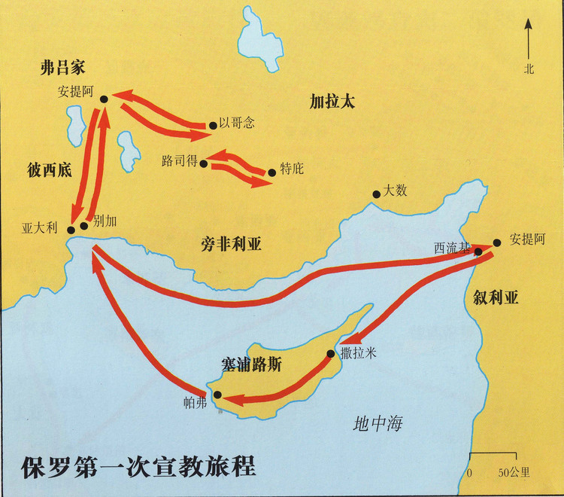

Slide 25
19但有些犹太人，从安提阿和以哥念来，挑唆众人，就用石头打保罗，以为他是死了，便拖到城外。 19Then some Jews came from Antioch and Iconium and won the crowd over. They stoned Paul and dragged him outside the city, thinking he was dead. --- 徒14：19/Acts 14:19

Slide 26
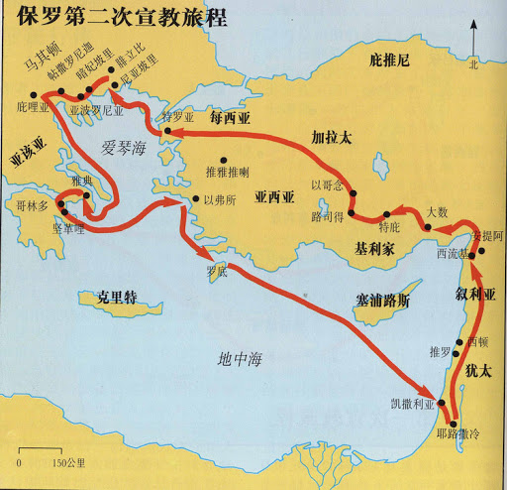
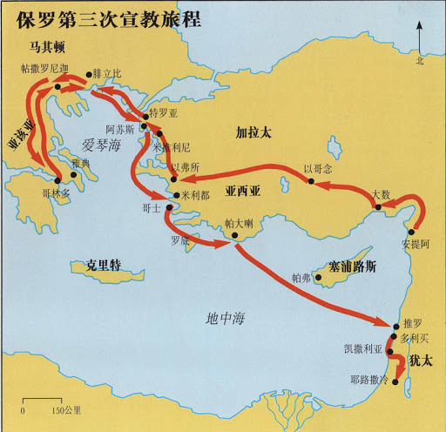

Slide 27
14无论是希利尼人，化外人，聪明人，愚拙人，我都欠他们的债。15所以情愿尽我的力量，将福音也传给你们在罗马的人。 14 I am a debtor both to Greeks and non-Greeks, both to the wise and the foolish. 15 That is why I am so eager to preach the gospel also to you who are in Rome. --- 罗1：14-15/Rom.1:14-15

Slide 28
总结 Summary

Slide 29
一、天国子民应当效法保罗的榜样
I. The citizens of heaven should follow the example of Paul.
* 效法保罗的忘记背后
二、天国子民应当防备十字架的仇敌
II. The citizens of heaven should be on guard against enemies of the cross of Christ
* 防备教会中的犹太主义者和纵欲主义者
三、天国子民应热切等候耶稣的再临
III. The citizens of heaven should eagerly await the second coming of Jesus Christ
* 竭力追求
我们是天国的子民

Slide 30
祈祷/Prayer

