Slide 1
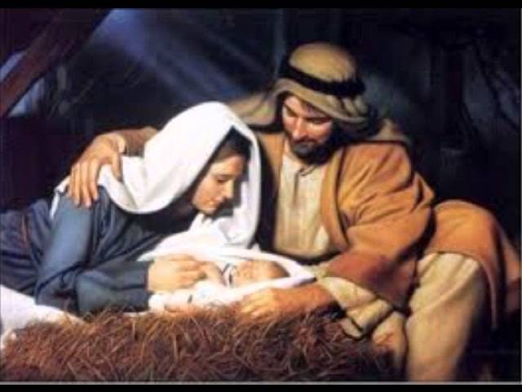
最美的礼物 Jesus---The Greatest Gift 太/Matt. 1：18-25

Slide 2
祈祷/Prayer

Slide 3
一、人类的困境 II. The Dilemma of Human beings 21她将要生一个儿子。你要给他起名叫耶稣。因他要将自己的百姓从罪恶里救出来。 21She will give birth to a son, and you are to give him the name Jesus, because he will save his people from their sins.’ 太/Matt. 1:21

Slide 4
1：1起初神创造天地 1In the beginning God created the heavens and the earth. 1：26-27：我们要照着我们的形像，按着我们的样式造人……神就照着自己的形象造人。 26Then God said, ‘Let us make mankind in our image, in our likeness…So God created mankind in his own image,in the image of God he created them. 创/Gen. 1:1; 26-27

Slide 5
1，犯罪之后，人失去了永恒的生命 1. After the Fall, human beings lost the eternal life.

Slide 6
罪的工价就是死/For the wages of sin is death. 从更古到永远，你是上帝/ from everlasting to everlasting you are God. 神造万物，各按其时成为美好。又将永生安置在世人心里/ He has made everything beautiful in its time. He has also set eternity in the human heart; 罗/Rom. 6：23; 诗/Psa. 90:1; 传/Ecc. 3:11

Slide 7
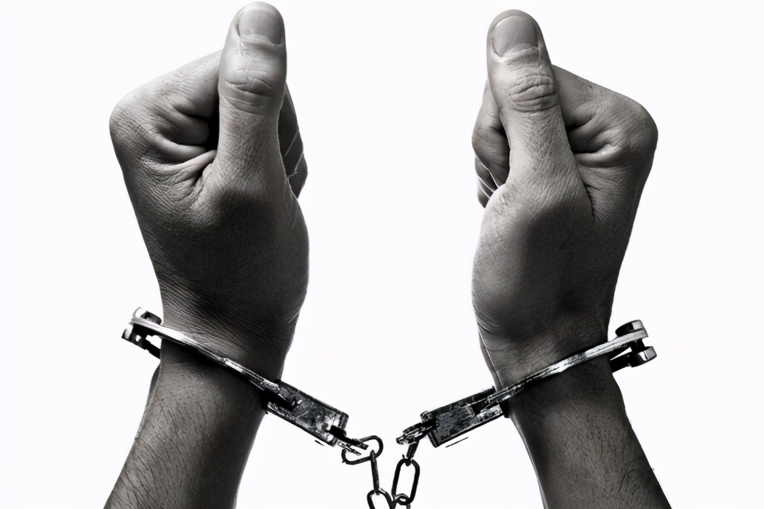
2，犯罪之后，人失去了不犯罪的自由 2. After the Fall, human beings lost the freedom not to sin.

Slide 8
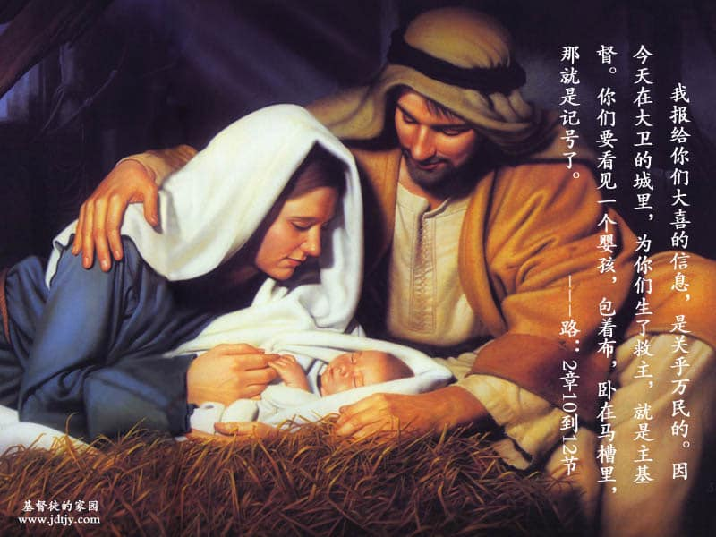
二、最美的礼物是圣子主耶稣 II. Jesus--- the Greatest Gift

Slide 9
20……不要怕，只管娶过你的妻子马利亚来。因她所怀的孕，是从圣灵来的。 20…Joseph son of David, do not be afraid to take Mary home as your wife, because what is conceived in her is from the Holy Spirit. 太/Matt. 1:21

Slide 10
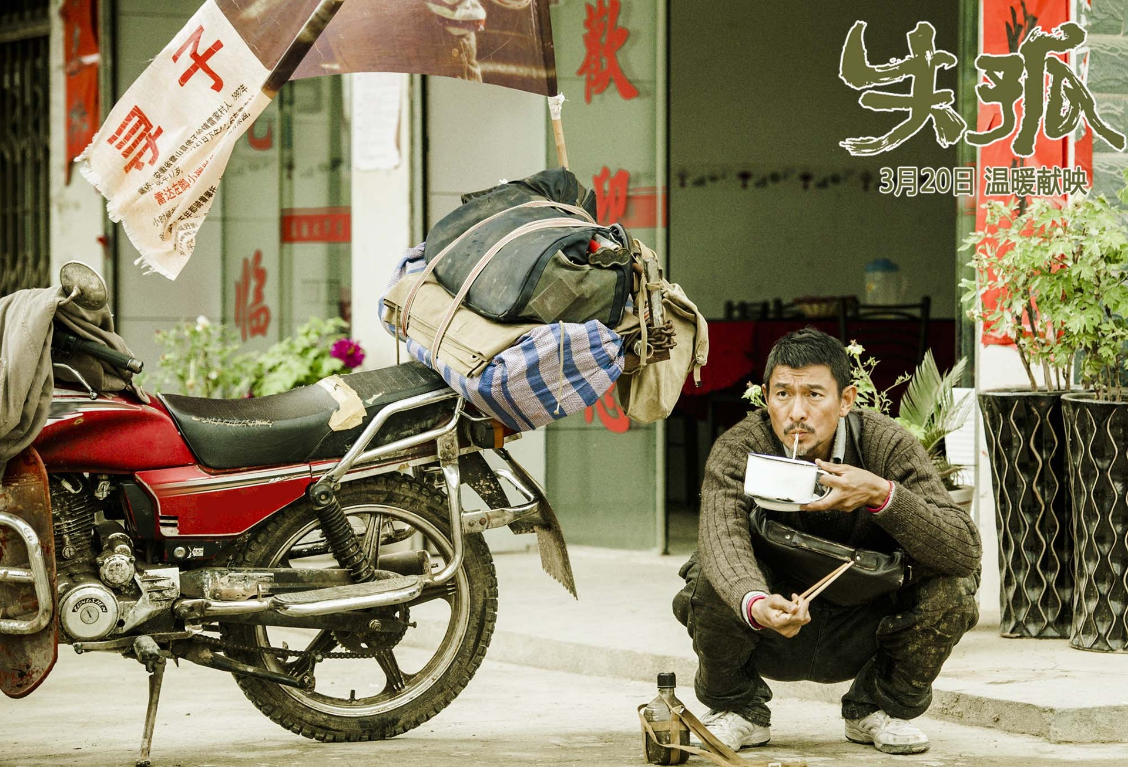
一、

Slide 11
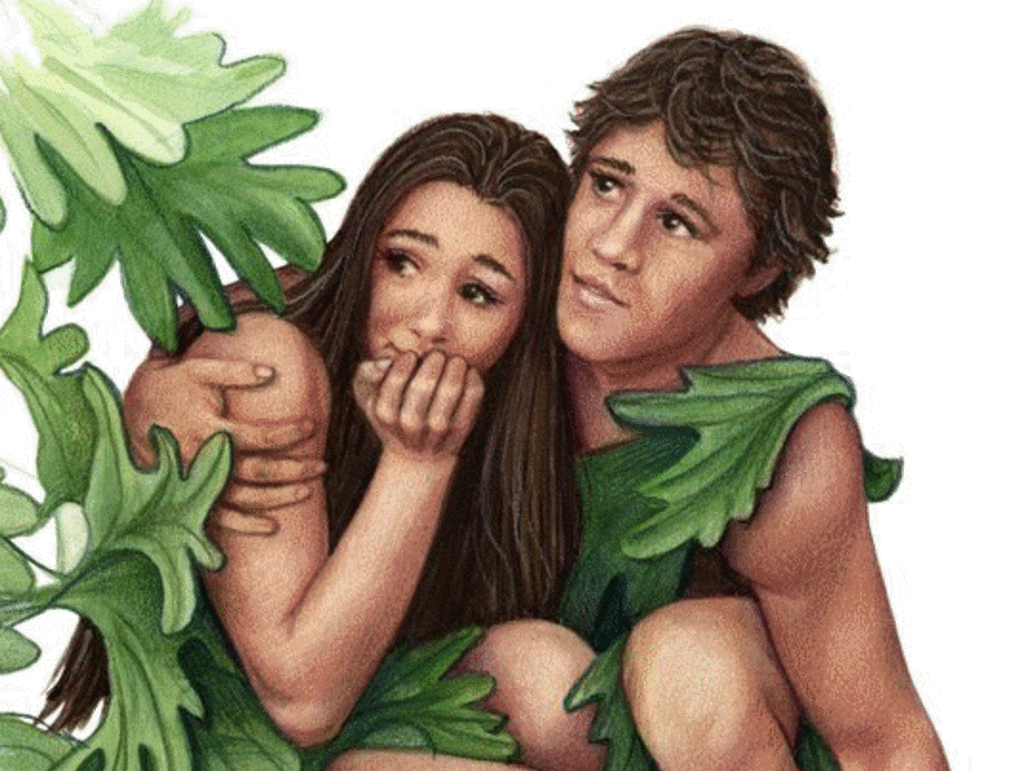
1、亚当，你在哪里？ 1. Adam, where are you?

Slide 12
12 是你所赐给我，与我同居的女人，她把那棵树上的果子给我，我就吃了。 The woman you put here with me – she gave me some fruit from the tree, and I ate it.’ 5耶和华见人在地上罪恶很大，终日所思想的尽都是恶。 5The Lord saw how great the wickedness of the human race had become on the earth, and that every inclination of the thoughts of the human heart was only evil all the time. 创/Gen. 3：12；6：5

Slide 13
11：4他们说，来吧，我们要建造一座城和一座塔 ，塔顶通天，为要传扬我们的名，免得我们分散在全地上。 Come, let us build ourselves a city, with a tower that reaches to the heavens, so that we may make a name for ourselves; otherwise we will be scattered over the face of the whole earth.’ 创 /Gen. 11:4

Slide 14
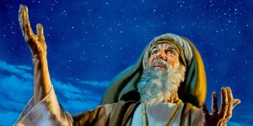
2、选召亚伯拉罕 2. The choosing of Abraham

Slide 15
1耶和华对亚伯兰说：“你要离开本地、本族、父家，往我所要指示你的地去。“我必叫你成为大国。我必赐福给你，叫你的名为大……地上的万族都要因你得福。” 1The Lord had said to Abram, ‘Go from your country, your people and your father’s household to the land I will show you. 2‘I will make you into a great nation, and I will bless you; I will make your name great…and all peoples on earthwill be blessed through you.’ 创/Gen. 12:1-3

Slide 16
4我向埃及人所行的事，你们都看见了，且看见我如鹰将你们背在翅膀上，带来归我……你们要归我作祭司的国度，为圣洁的国民。这些话你要告诉以色列人。 4“You yourselves have seen what I did to Egypt, and how I carried you on eagles’ wings and brought you to myself…you will be for me a kingdom of priests and a holy nation.” These are the words you are to speak to the Israelites.’ 出/Exo. 19：4-6

Slide 17
3、道成肉身 3. The Word became flesh 及至时候满足，神就差遣他的儿子，为女子所生，且生在律法以下，要把律法以下的人救出来，叫我们得着儿子的名份。 4But when the set time had fully come, God sent his Son, born of a woman, born under the law, 5to redeem those under the law, that we might receive adoption to sonship. 加/Cal. 4:4-5

Slide 18
1、有一件礼物，你收到没有，眼睛看不到，你心会知道，这一件礼物，心门外等候，是为了你准备，别人不能收。 2、亲爱的朋友，你是否想到，马槽的婴孩，是为你而来，亲爱的朋友，你是否了解，最好的礼物是人子主耶稣。 副歌：生命有限，时光也会走，如果你不珍惜，机会难留，礼物虽然好，如果你不要，你怎么能够得到，怎么能得到？

Slide 19
总结 Summary

