Slide 1
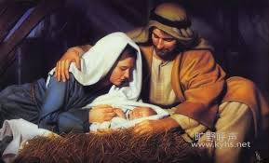
永恒之爱，为你而来 Eternal Love Has Come to You 约/John 3：16

Slide 2

祈祷/Prayer

Slide 3
一、爱的宣告：从一个“黑夜”开始 I. The Proclamation of Love: Beginning in the “Night” 1有一个法利赛人，名叫尼哥底母，是犹太人的官/ 1Now there was a Pharisee, a man named Nicodemus who was a member of the Jewish ruling council. 10耶稣回答说，你是以色列人的先生，还不明白这事吗/‘You are Israel’s teacher,’ said Jesus, ‘and do you not understand these things?

Slide 4
约19：39又有尼哥底母，就是先前夜里去见耶稣的，带着没药，和沉香，约有一百斤前来。40他们就照犹太人殡葬的规矩，把耶稣的身体，用细麻布加上香料裹好了。 39He was accompanied by Nicodemus, the man who earlier had visited Jesus at night. Nicodemus brought a mixture of myrrh and aloes, about thirty-five kilograms. 40Taking Jesus’ body, the two of them wrapped it, with the spices, in strips of linen…

Slide 5
耶和华神 1、“太初有道，道与神同在，道就是神”，他是在万有之先就已经存在的神。 2、创造天地万物的造物主 创1 :1 3、他的属性： 满有慈爱 绝对公义、圣洁 不以有罪的为无罪 恨恶罪，却爱人 审判罪，却为罪人预备拯救
世人 1、“世人都犯了罪，亏缺了神的荣耀”（罗 3:23）
2、“世人”并不是：道德高尚、配得神爱的人
3、“世人”乃是：
有罪的、堕落的
在本质上与神隔绝
在心思意念和生命方向上：
与神为敌的人

Slide 6

二、爱的对象——神爱世人 II. The Object of Love: God So Loved the World

Slide 7
3愿颂赞归与我们主耶稣基督的父神，他在基督里，曾赐给我们天上各样属灵的福气。4就如神从创立世界以前，在基督里拣选了我们，使我们在他面前成为圣洁，无有瑕疵。 3Praise be to the God and Father of our Lord Jesus Christ, who has blessed us in the heavenly realms with every spiritual blessing in Christ. 4For he chose us in him before the creation of the world to be holy and blameless in his sight. 弗/Eph. 1:3-4

Slide 8
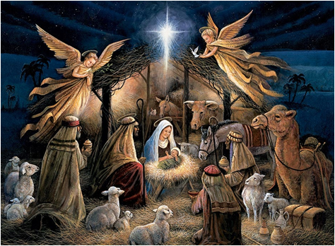
三、爱的行动——将他的独生子赐给我们 III. The Action of Love: He Gave His One and Only Son

Slide 9
宗教：人寻找神/Religion: People Searching for God 1、人靠自己的努力、修行、行为/People rely on their own efforts, works, and discipline 2、一步一步想要接近神/Step by step, they try to move closer to God 3、对人说:“你要够好、够圣洁、够努力，才能来到神的面前”/“You must be good enough, holy enough, and work hard enough to come before God.”
福音：神寻找人/The Gospel: God Searching for People
1、神因着他爱的本性/God, by His very nature of love。
2、主动走向人/Takes the initiative and comes toward us
3、对人说：“不是你先够好，而是你先被爱了”/“It is not that you were good enough first, but that you were loved first.”

Slide 10
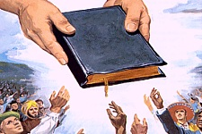
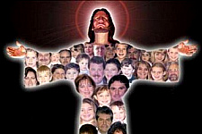
四、爱的邀请——叫一切信他的 IV. The Response to Love: That Whoever Believes in Him

Slide 11
什么是相信？ 信，不只是知道一些道理，或是头脑上的认同；信，也不只是一时的宗教情绪，更不只是到教会参加一次崇拜，或参与某些服侍。 信，是信靠。是完全的依赖，是把生命的主权交托给另一位，让他作主，让他掌权。
What does it mean to believe?
Faith is not merely knowing certain truths, nor is it just intellectual agreement.
It is not religious emotion,
nor is it simply attending a church service or participating in ministry.
Faith is trust.It is complete dependence,the surrender of the authority of one’s life to another—allowing Him to be Lord and to reign.

Slide 12
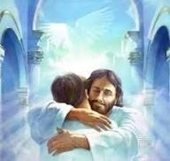
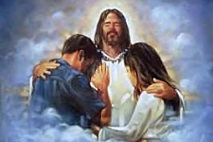
五、爱的应许——不至灭亡，反得永生 V. The Promise of Love: Shall Not Perish but Have Eternal Life

Slide 13

总结 Summary

