Slide 1
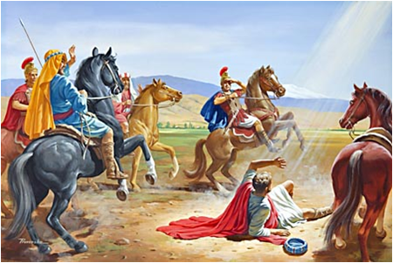
活出蒙福与祝福的人生 Living a life of Blessing and Being a Blessing 徒/Act.22：1-11

Slide 2

祈祷/Prayer

Slide 3
一、保罗的背景——热心却无知 3-4节 I.Paul’s Background---Zealous but Ignorant 3保罗说，我原是犹太人，生在基利家的大数，长在这城里，在迦玛列门下，按着我们祖宗严紧的律法受教，热心事奉神，象你们众人今日一样。 3‘I am a Jew, born in Tarsus of Cilicia, but brought up in this city. I studied under Gamaliel and was thoroughly trained in the law of our ancestors. I was just as zealous for God as any of you are today.

Slide 4
4我也曾逼迫奉这道的人，直到死地，无论男女都锁拿下监。 4I persecuted the followers of this Way to their death, arresting both men and women and throwing them into prison,

Slide 5
1、我原是犹太人 /I am a Jew A、 被拣选的子民/ God’s Chosen People B、 拥有律法与应许/Possessors of the Law and the Promises C 、圣洁子民身份/A Holy People with a distinct Identity

Slide 6
2、生在大数、长在耶路撒冷/Born in Tarsus, Brought Up in Jerusalem “生在基利家的大数，长在这城里，在迦玛列门下，按着我们祖宗严紧的律法受教。”… born in Tarsus of Cilicia, but brought up in this city. I studied under Gamaliel and was thoroughly trained in the law of our ancestors.

Slide 7
3、年轻有为、热心侍奉/Young, Promising, and Zealous in Service “……热心事奉神，象你们众人今日一样。4我也曾逼迫奉这道的人，直到死地，无论男女都锁拿下监。”I was just as zealous for God as any of you are today.I persecuted the followers of this Way to their death, arresting both men and women and throwing them into prison.

Slide 8
二、保罗人生的转择 ——蒙受主恩 5-8节 II. Paul’s Turning Point---Receiving the Lord’s Grace 5……我又领了他们达与弟兄的书信，往大马色去，要把在那里奉这道的人锁拿，带到耶路撒冷受刑。6我将到大马色，正走的时候，约在晌午，忽然从天上发大光，四面照着我。7我就仆倒在地，听见有声音对我说，扫罗，扫罗，你为什么逼迫我。8我回答说，主阿，你是谁？他说，我就是你所逼迫的拿撒勒人耶稣。

Slide 9
5...I even obtained letters from them to their associates in Damascus, and went there to bring these people as prisoners to Jerusalem to be punished.6‘About noon as I came near Damascus, suddenly a bright light from heaven flashed around me. 7I fell to the ground and heard a voice say to me, “Saul! Saul! Why do you persecute me?”8‘“Who are you, Lord?” I asked.‘“I am Jesus of Nazareth, whom you are persecuting,” he replied.

Slide 10
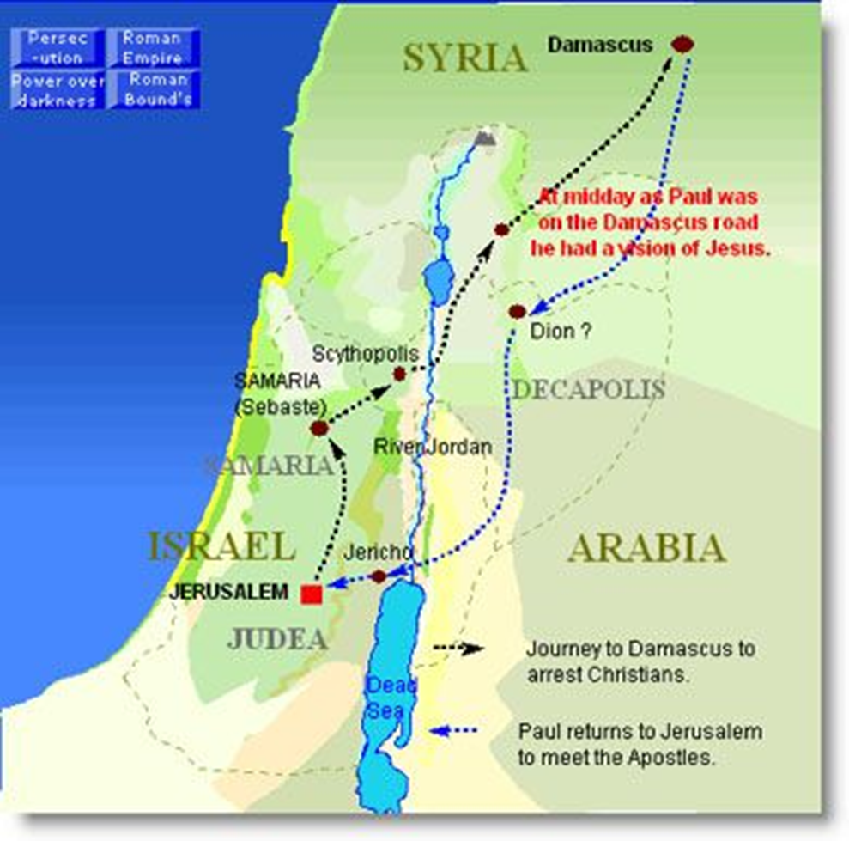
从耶路撒冷到大马士革的距离大约240–250公里。若是步行：可能需要 8–10天。骑马：可能需要5–6天 The distance from Jerusalem to Damascus is approximately 240–250 kilometers. On foot: it would likely take 8–10 days. By horse: it would take about 5–6 days.

Slide 11
……“扫罗，扫罗，你为什么逼迫我。”8我回答说，主阿，你是谁？他说，我就是你所逼迫的拿撒勒人耶稣。 Saul! Saul! Why do you persecute me?”8‘“Who are you, Lord?” I asked ‘“I am Jesus of Nazareth, whom you are persecuting,”

Slide 12
基督耶稣降世，为要拯救罪人……在罪人中我是个罪魁。然而我蒙了怜悯。 Christ Jesus came into the world to save sinners---Of whom I am the Worst. But I was shown mercy.” ——提前/1 Tim.1:15-16

Slide 13
三、保罗的回应——活出使命 10-11节 III. Paul’s Response---Living out His Mission 10 主阿，我当作什么。主说，起来，进大马色去，在那里要将所派你作的一切事，告诉你。 10‘“What shall I do, Lord?” I asked. ‘“Get up,” the Lord said, “and go into Damascus. There you will be told all that you have been assigned to do.”

Slide 14
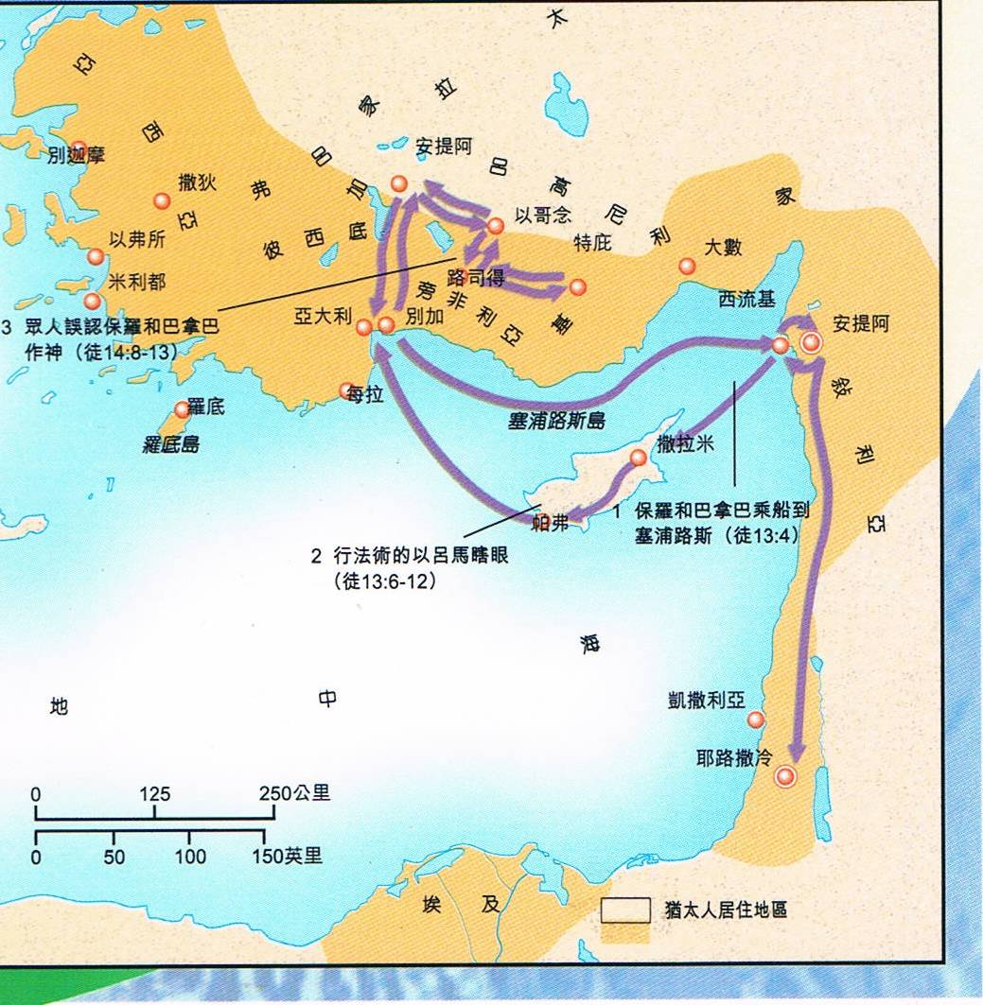
1、叙利亚的安提阿/Antioch in Syria 2、塞浦路斯岛/Cyprus 3、别加/Perga 4、彼希底的安提阿/Antioch in Pisidia 5、以哥念/Iconium 6、路司德/Lystra 7、特庇/Derbe

Slide 15
我想神把我们使徒明明列在末后，好像定死罪的囚犯。因为我们成了一台戏，给世人和天使观看。9For it seems to me that God has put us apostles on display at the end of the procession, like those condemned to die in the arena. We have been made a spectacle to the whole universe, to angels as well as to human beings. ——林前/1 Cro.4：9节

Slide 16
1、一个不以福音为耻的人 1, A Person Who is Not Ashamed of the Gospel 罗/Rom.1:16 我不以福音为耻，这福音本是神的大能，要救一切相信的。For I am not ashamed of the gospel, because it is the power of God that brings salvation to everyone who believes: first to the Jew, then to the Gentile.

Slide 17
2、一个欠福音债的人： 2, A person Indebted to the Gospel 罗/Rom. 1：14无论是希利尼人，化外人，聪明人，愚拙人，我都欠他们的债。15所以情愿尽我的力量，将福音也传给你们在罗马的人。14I am a debtor both to Greeks and non-Greeks, both to the wise and the foolish. 15That is why I am so eager to preach the gospel also to you who are in Rome.

Slide 18
3、一个为着福音不以性命为念的人 3, A Person Who Counts Not His Life for the Gospel 徒/Act 20:24 我却不以性命为念，也不看为宝贵，只要行完我的路程，成就我从主耶稣所领受的职事，证明神恩惠的福音。However, I consider my life worth nothing to me; my only aim is to finish the race and complete the task the Lord Jesus has given me – the task of testifying to the good news of God’s grace.

Slide 19
总结 Summary

